Slide 1
ENSTA 3A – Mesure de concentration par ADCP
2019-2020

Slide 2
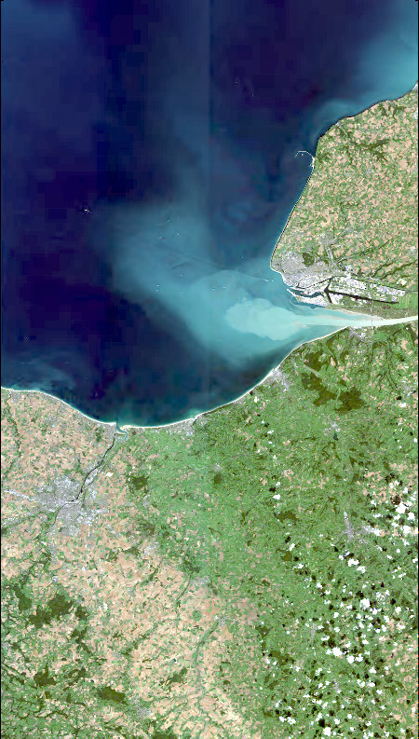
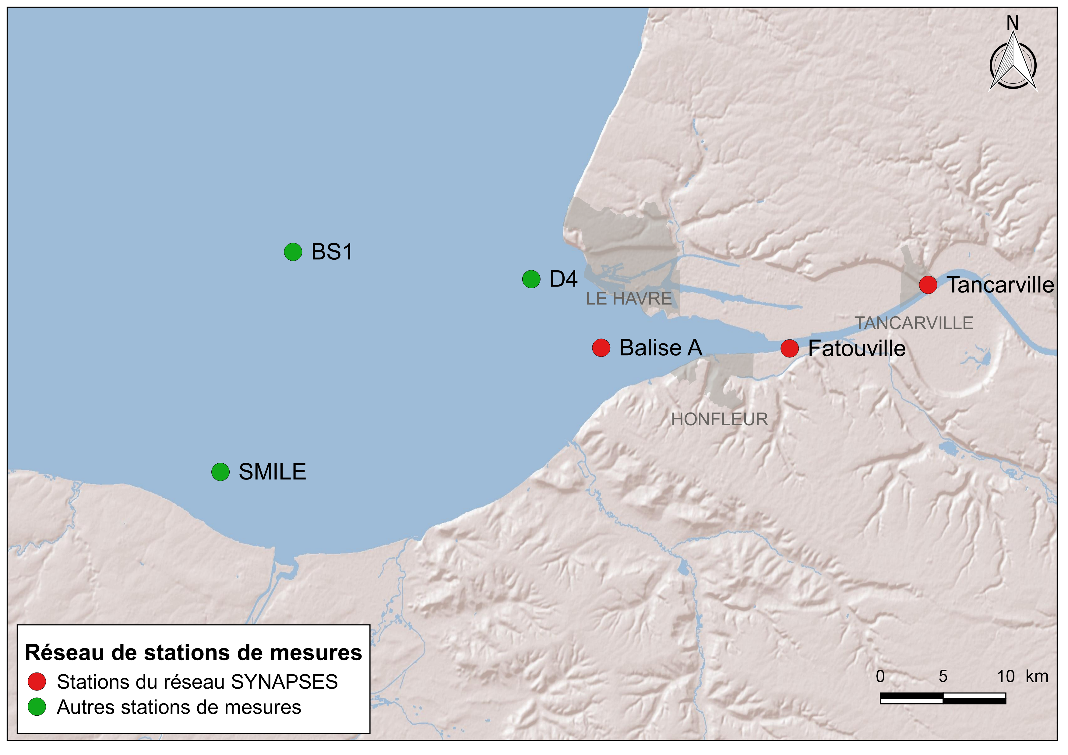
0.001g/l
0.01g/l
0.1g/l
1g/l
Notes:
Zone d’eau peu profonde
Courrant de marée modéré autour de 1m/S
Gradient des MES
So as I said before, interface between estuary and Bay is characterized by strong turbidity, gradient. It is the case in the eastern part if the Bay, with a turbidity of few g/L in red stations on the map, But This part of the Seine is the subject of a PhD thesis of Flavie Druine who will present you her work later.
Our study site is more located at the green stations In the Baywith a turbidity below hundred mg/.
The study site is characterized by a shallow water area (10-20 m) and by moderate tidal currents around 1 m/s.
The SPM gradient varies along tidal phases with a SPM concentration (SSC) of a few mg/l during marée haute en mortes eaux (typical of particules de mer cotière
and up to a hundred mg/l (160 mg/l) during vives eaux and marée descendante(representative of riverine particles).
During periods of strong tidal currents (both ebb and flood), bottom material can also be resuspended.

Slide 5
Wetlabs Surface
Hydrocat Surface
Acoustic beam
Cell i (distance… from the bed?)
Awac
Wetlabs bottom

